Slide 1
Hydration for athletic performance
By: Katie Horrell
Notes:
Today we are going to talk about Hydration for Athletic performance.
How many of you have ever felt the effects of being dehydrated?
Have you ever felt like you drank too much water?
I’m going to make two columns on the board, and I would like everyone to fill in one or more descriptions for each column.
Before Podcast, have students come up to the board and write signs of dehydration and signs of overhydration that they know of.
Suggest them trying to list at least one each.

Slide 2
How much should I Drink?
Nutrition Diva:
http://www.quickanddirtytips.com/health-fitness/healthy-eating/how-much-water-should-i-drink
What are you thoughts?
Notes:
Before Podcast, have students come up to the board and write signs of dehydration and signs of overhydration that they know of.

Slide 3
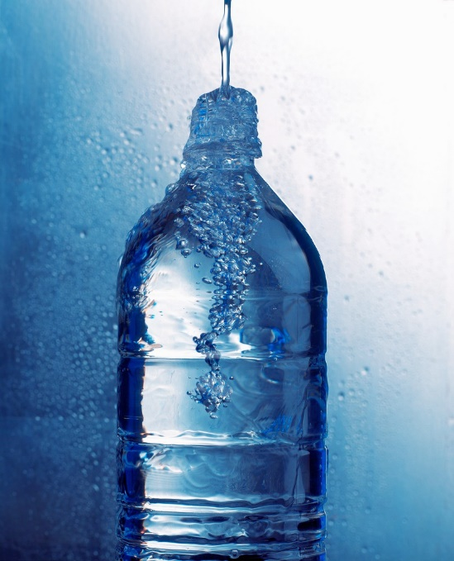
How do we measure thirst?
Urine color
Sweat Loss
-1% to +1% - Optimal
-3% to -5% significant dehydration
>5% Severe dehydration
Estimated needs
~ half body weight in fluid ounces
(Academy of Nutrition and Dietetics, 2013)
(Simpson & Howard, 2011)
Notes:
Pale Yellow is optimal for your body’s way of telling you that you are hydrated.
Dark yellow or even light yellow can mean you are borderline dehydrated or currently dehydrated.
Estimated needs:
Some say half body weight in fluid ounces… for example, 140 lb man would have 70 oz, or about 8.5 cups

Slide 4
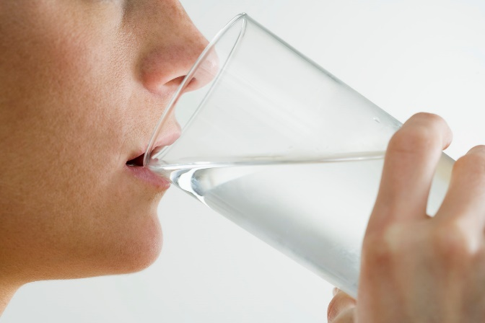
Early signs of dehydration
Thirst
Flushed skin
Premature fatigue
Increased body temperature
Faster breathing and pulse rate
Increased perception of effort
Decreased exercise capacity
(Academy of Nutrition and Dietetics, 2013)
Notes:
If you’re thirsty, you’re already slightly dehydrated!
The more dehydrated you are, the harder it will be to do physical activity
Do not want to over hydrate either

Slide 5
Late Signs of dehydration
Dizziness
Increased weakness
Labored breathing with exercise
(Academy of Nutrition and Dietetics, 2013)

Slide 6
Is more always better?
Also called “Water intoxication”
Can result in
Behavior changes
Confusion
Nausea/vomiting
Muscle cramps
death
(Simpson & Howard, 2011)
Notes:
Although death from water intoxication is uncommon, it can happen, especially in marathon runners or athletes in special events.
What occurs is called hyponatremia, which means your body is low in Sodium, which is a mineral that is needed in certain amounts for body and brain function. When someone dilutes the Sodium in their body to extreme extents it can result in death.
-woman died in water drinking contest for radio station. Drank 6 liters of water in 3 hours and died from water intoxication.
-do not stress this, but be aware of the potential dangers and watch your urine! If it’s pale, lay off the water for a few hours.

Slide 7
What can I do to stay hydrated?
Fluid needs vary
Before
Drink 16-20 fl oz water 4 hours before exercise
How Many cups is this?
Drink 8-12 fl oz water 10-15 mins before exercise
During
Drink 3-8 fl oz water every 15-20 mins when exercising <1 hour
Drink 3-8 fl oz sports drink every 15-20 mins when exercising >1 hour
Simpson & Howard, 2011
Notes:
How many ounces are in one cup?
How does this compare to what you drink?
(Do glass filling activity using liquid measuring cup and pouring into clear glasses to demonstrate fluid needs before, during, and after workouts)

Slide 8
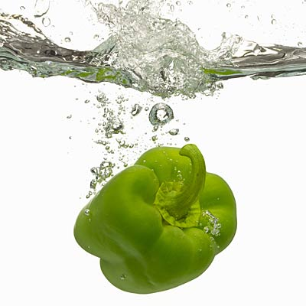
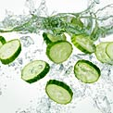
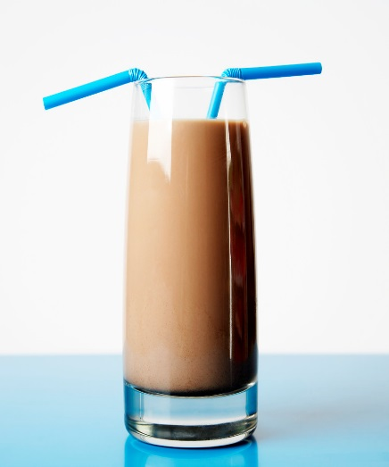
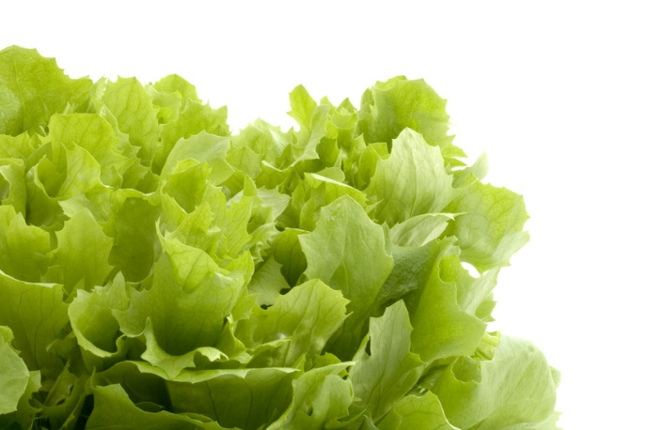
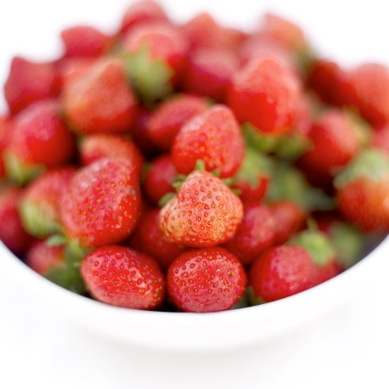
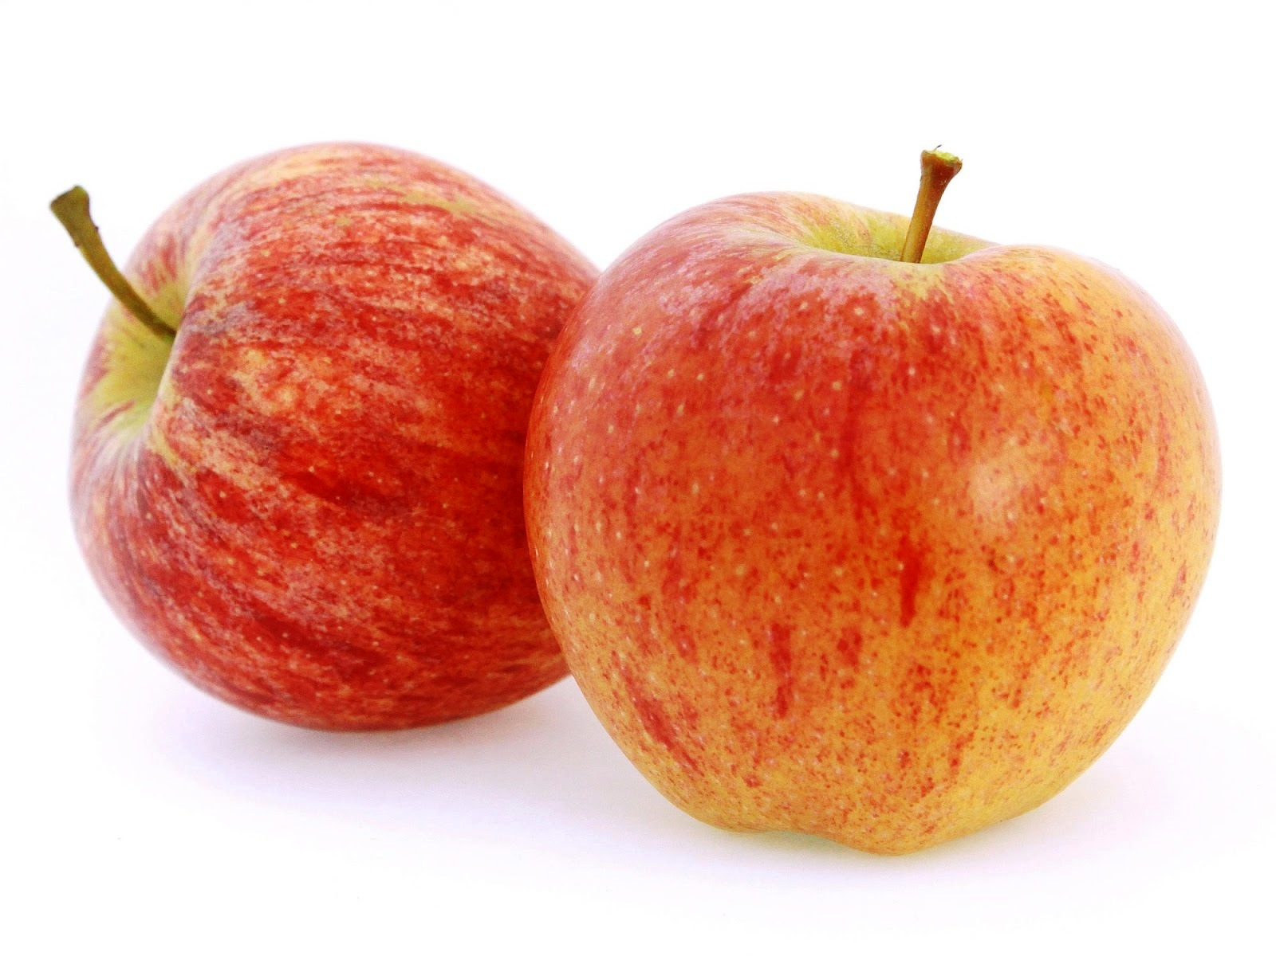
Hydration beyond h2o
(Green Peppers, 2013)
(Cucumbers, 2013)
(Apples, 2014)
Notes:
What other foods can you think of that contain lots of water?
-Jello, pudding, yogurt, grapes, team coffee, etc.

Slide 9
References
Cucumbers. (2013). [Web Image] Retrieved from
http://img2.timeinc.net/health/img/mag/2013/07/cucumber-hydrating-food-122x122.jpg
Green Pepper. (2013). [Web Image] Retrieved from
http://img2.timeinc.net/health/img/mag/2013/07/green-peppers-hydrating-food400x400.jpg
Apples. (2014). [Web Image] Retrieved from
http://www.grosvenormarket.com/blog/wp-content/uploads/2014/09/apples-gala.jpg
Reinagel, M. (2010). [Web page] Retrieved from
http://www.quickanddirtytips.com/health-fitness/healthy-eating/how-much-water-should-i-drink
Simpson, M. R. & Howard, T. (2011). Selecting and Effectively Using Hydration for Fitness. [Web Brochure] Retrieved from http://www.acsm.org/docs/brochures/selecting-and-effectively-using-hydration-for-fitness.pdf

