Slide 1
Snacking For Fuel
Healthy snacking 101 by Katie horrell

Slide 2
Healthy Snacking Pre-Assessment
What’s your definition of “convenience food”?
Define a “healthy” or “balanced” convenience food?
Can you name a few healthy snacks?
Notes:
What comes to mind when you think of the phrases “Snack foods” and “convenience foods”? Positive or Negative?

Slide 3
Convenience Food Defined
1. “(Cookery) food that needs little preparation, especially food that has been pre-prepared and preserved for long-term storage” (thefreedictionary.com, 2003)
2. “A prepackaged food that can be prepared quickly and easily.” (thefreedictionary.com, 2009)
Pre-packaged foods are best when used in moderation
Non-processed portable snacks?
Notes:
Pre-packaged foods, such as protein shakes or protein bars should not serve as daily meal replacements
Non-processed portable snacks: Apples, bananas, carrots, oranges…

Slide 4
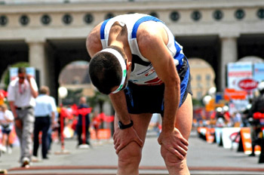
Consequences of Poor Nutritional Balance on Performance
Fatigue/suboptimal performance
Poor growth
Loss of muscle mass/bone density
Increased risk of illness,
inflammation, and injury
Longer healing time
(Rodriguez N.R., DiMarco, N.M., and Langley, S.A., 2009)
Retrieved from: www.kaysportsandfitness.com
Notes:
We may ask ourselves, “Why does it make a difference? Foods is food… as long as I’m getting the calories in then I’m fueling my workouts”… But this is not necessarily the case. We need proper nutrients and a balance of different food groups like carbohydrates, proteins, and fats to fuel our mind and body for exertion.

Slide 5
What makes a balanced snack?
Combination of:
  Carbohydrates
  Protein
  Fat
  (Marcason, 2012)

Slide 6
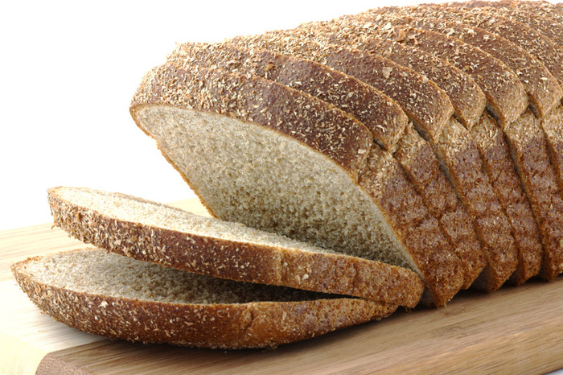
Carbohydrates
Includes:
Whole grains
Fruits
  100% Fruit juices, dried fruit, fresh
Vegetables
Snacking Examples:
Whole grain crackers, whole grain wrap, apple, banana, whole grain cereal, granola bar, baby carrots, bell pepper slices
Retrieved from: Networkingfutures.com

Slide 7
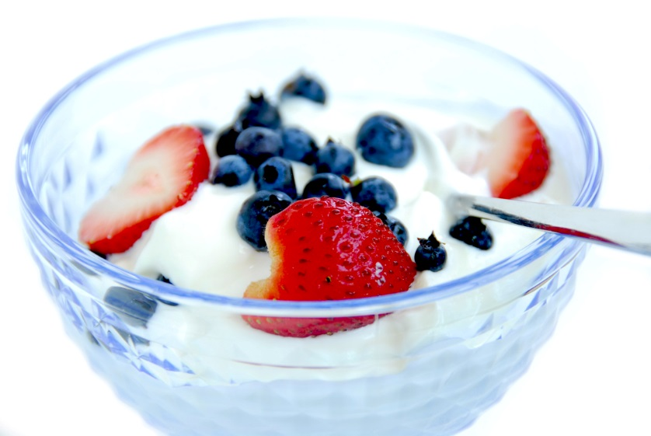
Protein
Includes:
Cheese
Milk
Yogurt
Meat
Nutritional bars
Snacking Examples:
Mozzarella Cheese sticks, cottage cheese, regular or chocolate milk, Greek yogurt, protein powder, protein bars, beef/turkey jerky

Slide 8
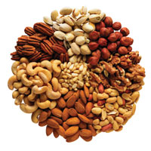
Fats
Includes:
Nuts
  whole, chopped, nut butters
Seeds
Oils
Olives
Snacking Examples:
Peanut butter, almonds, pistachios, olive oil, pumpkin seeds, sunflower seeds, vinaigrette dressings, walnuts, dark chocolate
Retrieved from: www.mylocalhealth.com
(Marcason, 2012)

Slide 9
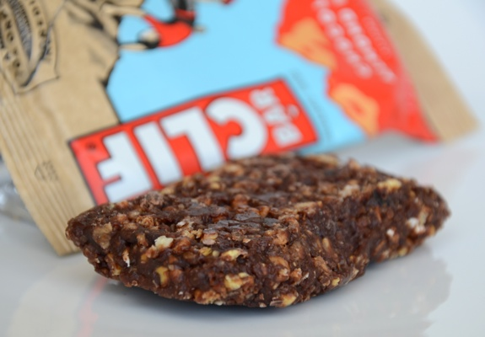
Looking for Balance in Pre-packaged Foods
Combo of fiber and protein
  >3 grams fiber, >3 grams protein
  150-250 calories
Examples
  Whole wheat wrap and peanut butter
  Greek yogurt and strawberries
  Mozzarella cheese stick and whole wheat crackers
  Protein bars: those that fit criteria above
    Clif bar, Luna Bar, KindBar, etc.
  (Cooking Light, n.d)
Retrieved from: www.nearof.com
Notes:
Can packaged foods be healthy?
Some packaged foods will not meet these requirements by themselves, therefore doing combos of high-fiber foods with protein packed foods is a good options
Protein bars like the one pictured are meant to provide balanced energy in the form of carbohydrates, protein, AND fats.
What could you look for on the label of a packaged food to ensure it was a balanced choice?
Do you know of any convenience foods that fit these descriptions?

Slide 10
Looking for Balance in Pre-packaged Foods: Protein Bars
Label comparison activity
http://www.nutritionjungle.com/images/products/metrx/elements/Colos-Brownie-PB-LABEL.png
Vs
http://www.lunabar.com/products/luna-bar/caramel-nut-brownie#nutrition-facts
Notes:
On each label:
-Star the positives
-Circle the negatives
Which do you think is the better choice?
-Why?
-Does it meet the criteria we talked about on the previous slide?

Slide 11
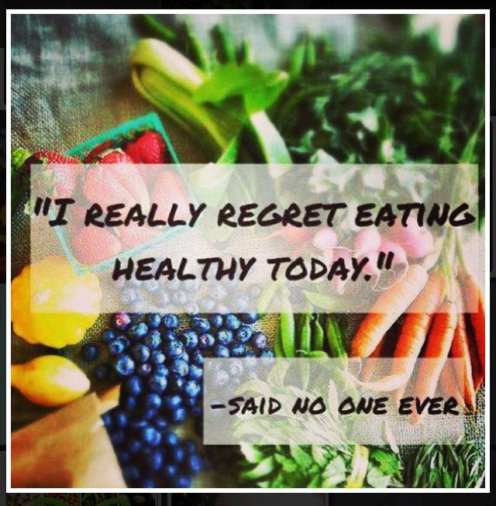
How Can Healthy Snacking Effect You?
Keeps blood sugar steady
Improve Confidence
Fuels mind & body
  Mood-lifting
Said No One Ever, (n.d)
Notes:
Blood Sugar: Your blood sugar drops about 3-5 hours after you eat. If you eat within those time periods, you are less likely to have raid your fridge for the first thing you see, buy a candy bar at the venting machine after convincing yourself you’re starving to death, or feel the mood shifts that low blood sugar gives us. In other terms, “Hangry”
Confidence: There’s something about eating better and fueling your body better that makes a person gain a sense of confidence. Eating nutritiously does not directly equal improved confidence, but doing something to better your performance and promote a healthy lifestyle is something everyone can feel confident about, no matter your weight or activity level.
Mind & Body: Think of fuel as the gasoline to your engine. The higher quality of fuel that goes in, leads to a faster, more efficient the engine runs. Short changing your body of important nutrients can effect physical AND mental performance.
Many of us will turn to carbs when we’re feeling down mentally, or sluggish and tired physically. The reason for this is, carbohydrates help lift our moods by boosting the brain chemical serotonin. When we eat processed foods like chips, cookies, and refined white breads, this mood boost is short-lived and we have a crash of blood sugar. Eating whole wheat options like whole wheat crackers, paired with protein and fat, such as peanut butter… can help prevent these crashes.
Fiber and Protein will slow the downward slope of blood sugar.

Slide 12
References
Loaf of Bread (n.d) [Photograph] Retrieved from
http://networkingfutures.com/photographymhx/whole-wheat-bread-brands-australia
Tired Runner (n.d) [Photograph] Retrieved from
http://www.oksportsandfitness.com/artwork/tired_runner.jpg
Nuts (2009) [Photograph] Retrieved from
http://www.mylocalhealth.com/images/articles/Trailmix_DietPlan.jpg
Rodriguez N.R., DiMarco N.M., & Langley S.A. (2009). Position of the American Dietetic Association, Dietitians of Canada, and the American College of Sports Medicine: Nutrition and Athletic Performance. Journal of the American Dietetic Association.109(3), 509-52. doi: 10.1016/j.jada.2009.01.005
Marcason, W. (2012) Build Muscle, No Steak Required. [Webpage] Retrieved from
http://www.eatright.org/Public/content.aspx?id=6442463961
Cooking Light (n.d.) Zeroing In On the Best Energy Bars. [Webpage] Retrieved from
http://www.cookinglight.com/eating-smart/smart-choices/best-energy-bars

Slide 13
References cont.
Baertlein, L. (2014) Healthy Snacking Benefits. [Webpage] Retrieved from
http://www.everydayhealth.com/diet-nutrition/meal-planning/healthy-snacking-benefits.aspx
Luna Bar Ingredients (n.d.) [Photograph] Retrieved from
http://2.bp.blogspot.com/-IONxw0EhbNg/UEbAoiL7BGI/AAAAAAAAF70/gP-CPctc9CA/s1600/ingredients+THEIRS.jpg
Luna Bar Nutrition Label (n.d.) [Photograph] Retrieved from
https://www.supplementwarehouse.com/ing/4846.gif
Metrx Protein Bar Label (n.d.) [Photograph] Retrieved from
  http://www.nutritionjungle.com/images/products/metrx/elements/Colos-Brownie-PB-LABEL.png
Said No One Ever. (n.d.) [Photograph] Retrieved from
http://papasteves.com/blogs/news/6931136-dates-diabetes-are-dates-good-for-sugar- diabetic-patient

